Slide 1
AI Intro Basics #6
CI/CD Continuous Integration and Continuous Deployment of ML codes
Florian Prill, Marek Jacob

Slide 2

E-AI Basic Tutorials
Tutorial E-AI Basics 4: January Wednesday 22, 2025, 11-12 CET
"MLOps" - Machine Learning Operations
4.1 Overview (20') [RP]
4.2 MLOps in relation to traditional Weather forecasting (20') [MJ]
4.3 Road to MLOps (20’) [DN]
Tutorial E-AI Basics 5: February Wednesday 19, 2025, 11-12 CET
MLflow - an open-source platform for managing the machine learning lifecycle
5.1 Overview - User perspective (20') [TG]
5.2 Logging to MLflow as a ML software developer (20') [HT]
5.3 Running MLflow server as a user and as a service (20') [MJ]
Tutorial E-AI Basics 6: February Wednesday 26, 2025, 11-12 CET
CI/CD - Continuous Integration and Continuous Deployment of ML codes
6.1 Overview – What can CI/CD do for you? (20') [MJ]
6.2 Basic tests with Pytest (20') [JD] [MJ]
6.3 Setting up a runner (20') [FP]
6.1
AI generated Image, © Marek Jacob 2024

Slide 3
Definition
Continuous Integration
Frequent merging of several small changes into a main branch.
Integrated codebase is in a workable state.
Continuous Delivery
Produce software in short cycles.
Ensure that software can be reliably released at any time.
Continuous Deployment
Actual automated deployment of the deliverables
Continuous Development
Collective term for the above
Compiling, Linking, Packaging
Verification and testing
Deployment services
CI/CD
Development
Operation
Activities

Slide 4
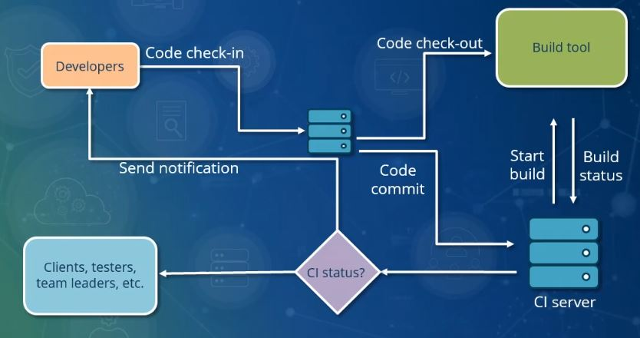
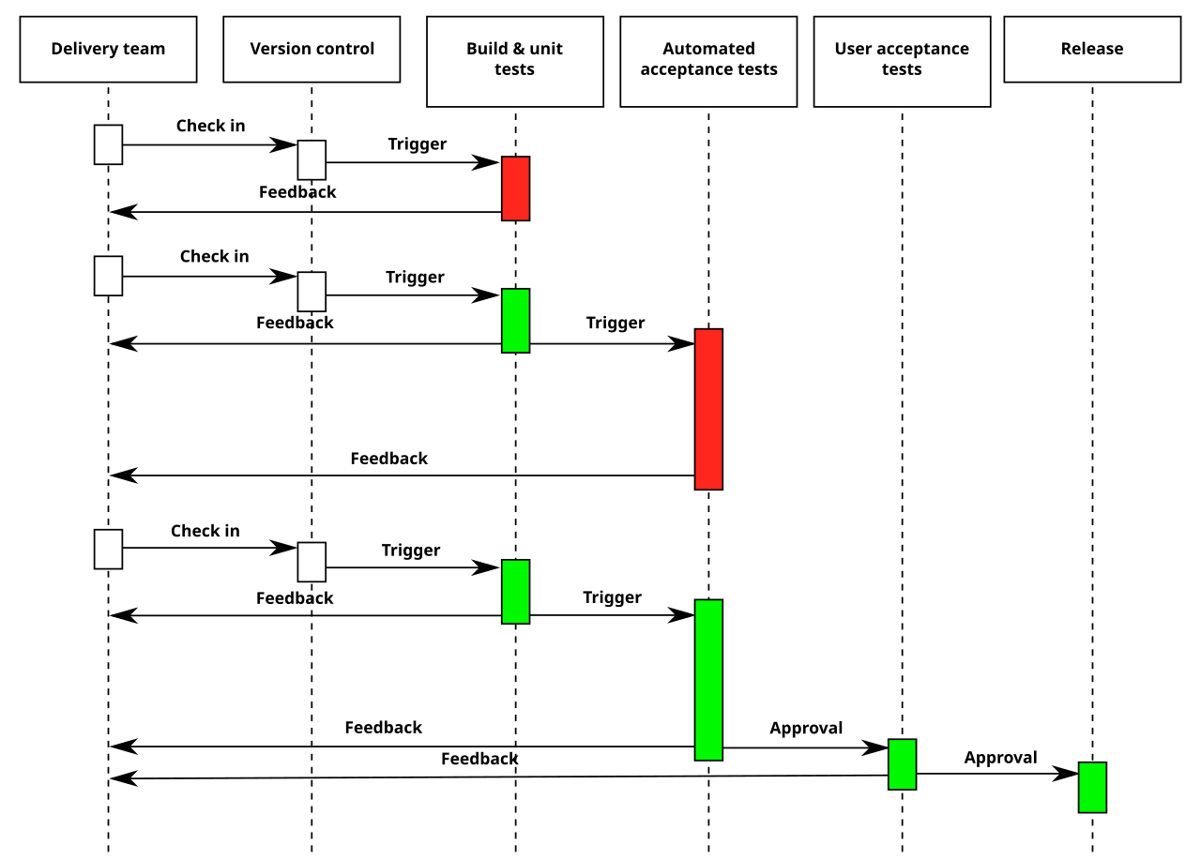
Integration flow-chart by Pratik89Roy, CC BY-SA 4.0
Deployment Pipeline by Grégoire Détrez, original by Jez Humble, CC BY-SA 4.0

Slide 5
CI/CD Services
Continuous Integration (CI):
Automated Building: Automatically build your project on each code change.
Code Quality Checks: Run static code analysis, linting, and formatting checks.
Unit Testing & Integration Testing: Execute automated tests to ensure code quality.
Code Review Assistance: Provide insights for code reviews, enabling more efficient feedback.
Dependency Management: Monitor and manage dependencies.
Continuous Delivery (CD):
Automated Deployment: Deploy your application to testing, staging, or production environments.
Environment Management: Manage multiple environments (e.g., dev, staging, prod) with ease.
Deployment to Various Platforms: Deploy to cloud providers (e.g., AWS, GCP, Azure), containerization platforms (e.g., Docker), or on-premises infrastructure.
Rollbacks & Version Control: Easily roll back to previous versions if issues arise.
Zero-Downtime Deployments: Achieve seamless, zero-downtime deployments for minimal user impact.
Shared Benefits (CI & CD):
Improved Collaboration: Enhance team collaboration by providing a shared, automated workflow.
Increased Quality & Reliability: Ensure higher code quality through automated testing and reviews.
Reduced Risk & Errors: Minimize the risk of human error through automation.
Enhanced Visibility & Monitoring: Gain insights into your pipeline's performance and application health.
Scalability & Flexibility: Easily scale your pipeline to accommodate growing project needs.
Compliance & Security: Meet regulatory requirements and maintain security through auditable, automated processes.
Cost Optimization: Reduce costs associated with manual processes, downtime, and error resolution.
Additional Advanced Capabilities:
Continuous Monitoring (CM): Extend CI/CD with ongoing performance and health monitoring.
Continuous Testing (CT): Incorporate more comprehensive testing strategies, including end-to-end and UI testing.
Continuous Feedback: Implement feedback loops to improve the development process based on user and system insights.

Slide 6
CI/CD Orchestrators
Local Solutions
Git Hooks
Makefiles
Centralized Git Repository Services
GitLab, GitHub, Bitbucket, Gitea, …
Automation Tools
Jenkins, Travis CI, Buildbot…

Slide 7
(Client-side) Git Hooks
Hook: A script that is triggered automatically with certain git actions
In .git/hooks/
E.g. .git/hooks/pre-commit
Executed by git commit before the snapshot is committed
If pre-commit exit status != 0 → aborts the commit
mv .git/hooks/pre-commit.sample .git/hooks/pre-commit
chmod +x .git/hooks/pre-commit
# pre-commit:
echo “foo bar “ > test
git add test
git commit –m “testing pre-commit”
Hooks are not stored and synchronised with git!
Sharing hooks across project is painful
… git diff-index --check --cached $against --
!
Checks for trailing whitespaces
test:1: trailing whitespace.
+foo bar_
https://git-scm.com/book/en/v2/Customizing-Git-Git-Hooks

Slide 8
Pre-commit
Install: pip install pre-commit
Create file .pre-commit-config.yaml in git (version controlled)
Install the git hook scripts: pre-commit install
(Optional) Manually run against all files: pre-commit run --all-files
repos:
- repo: https://github.com/pre-commit/pre-commit-hooks
rev: v5.0.0
hooks:
- id: end-of-file-fixer
- id: trailing-whitespace
- repo: https://github.com/psf/black
rev: 22.10.0
hooks:
- id: black
https://pre-commit.com/

Slide 9
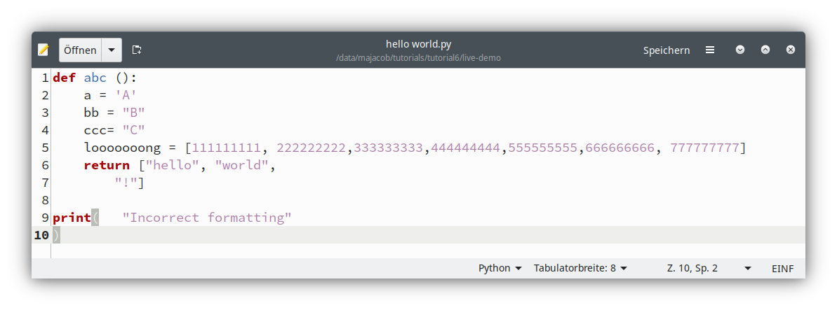
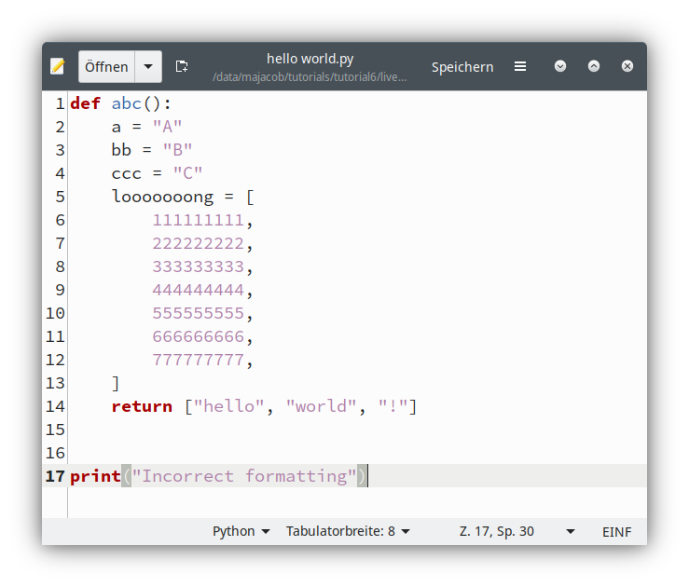
Python Black
An auto-formatter for Python
Fast
Deterministic
General rules
Readable code
Opinionated
Purposely limited configuration
Manual execution
pip install black
black "hello world.py"
Or with pre-commit

Slide 10
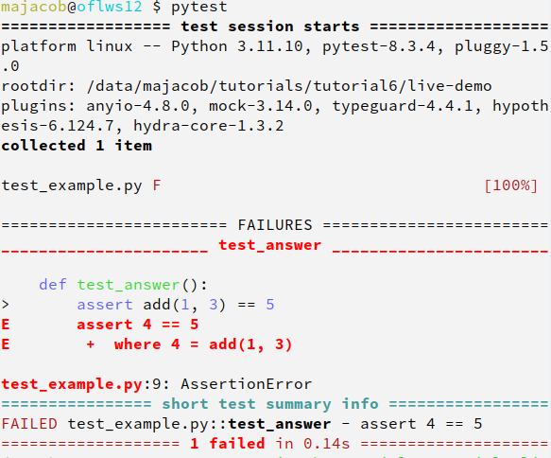
Pytest
# content of test_example.py
def add(a, b):
return a + b
def test_answer():
assert add(1, 3) == 5
Pytest: a framework for writing (software) tests
Small and readable tests
Auto-discovery of test modules and functions
Detailed info on failing assert statements (no need to remember self.assert* names)
Modular fixtures for managing small or parametrized long-lived test resources
Can run unittest (including trial) test suites out of the box
Python 3.8+
Install: pip install pyptest
Auto-discovery:
Recurse into directories, search for test_*.py or *_test.py files
test prefixed test functions or methods (outside of classes)
test prefixed test functions or methods inside Test prefixed test classes
https://docs.pytest.org/

Slide 11
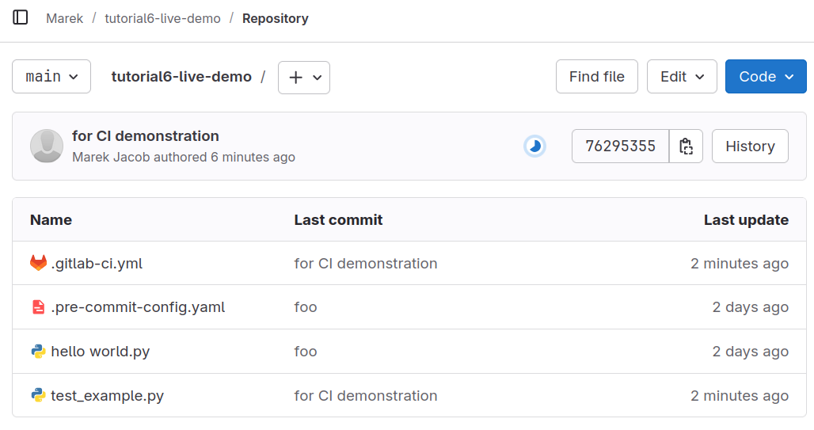
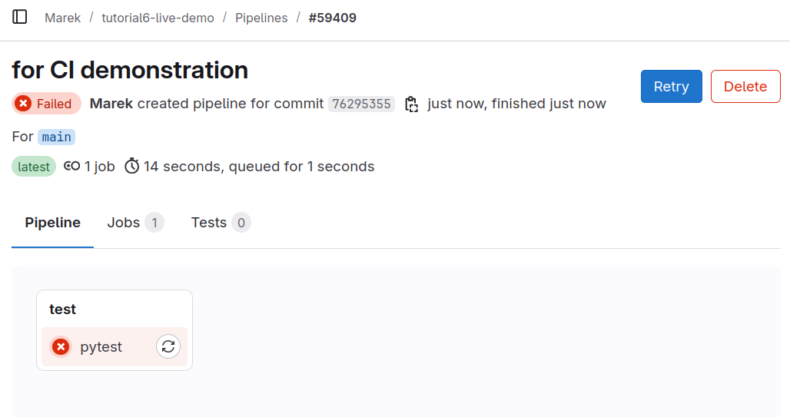
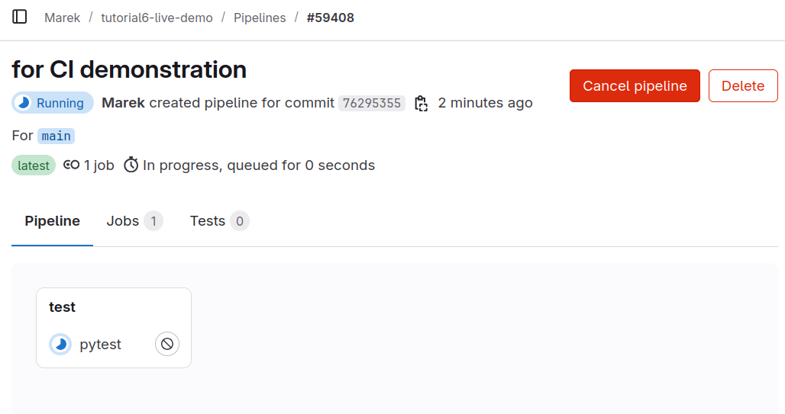
Simple GitLab CI with Pytest
# content of .gitlab-ci.yml
stages:
- test
pytest:
stage: test
image: python:3.10
script:
- pip install pytest
- pytest
Arbitrary job name
Arbitrary stage name
External docker image
waiting
Executed commands.
If any exit status != 0 → pipeline fails
https://docs.gitlab.com/ci/yaml/

Slide 12
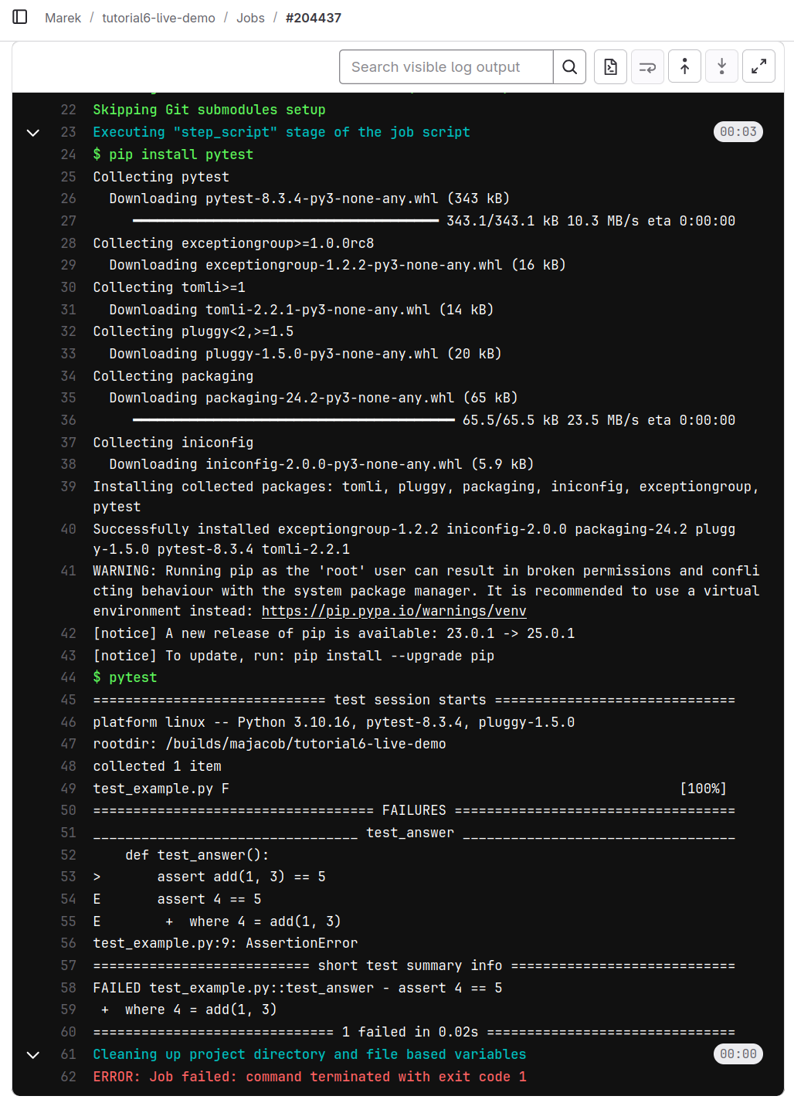
Simple GitLab CI with Pytest
# content of .gitlab-ci.yml
stages:
- test
pytest:
stage: test
image: python:3.10
script:
- pip install pytest
- pytest
Arbitrary job name
Arbitrary stage name
External docker image
Executed commands.
If any exit status != 0 → pipeline fails
https://docs.gitlab.com/ci/yaml/

Slide 13
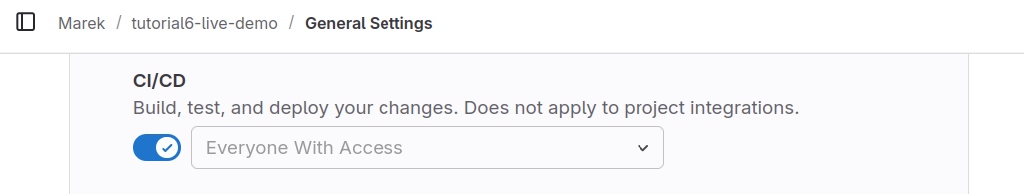
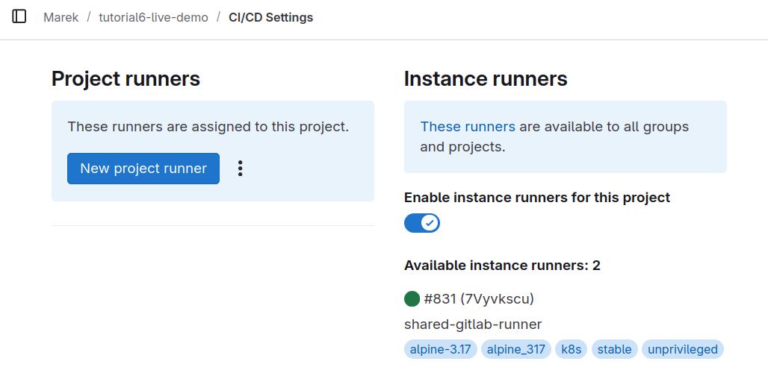
Key Settings for GitLab CI
Enable CI/CD under Project Settings → General → “Visibility, project features, permissions”
Enable (suitable runner) under Project Settings → CI/CD → Runners
Runners my offer different capabilities
Runner for arbitrary docker containers
Or preconfigured containerized systems
Specific runner can be chosen using the tags keyword
https://docs.gitlab.com/ci/runners/

Slide 14
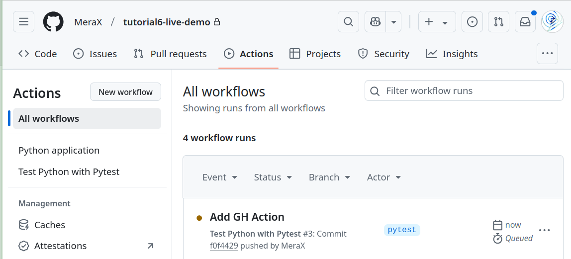
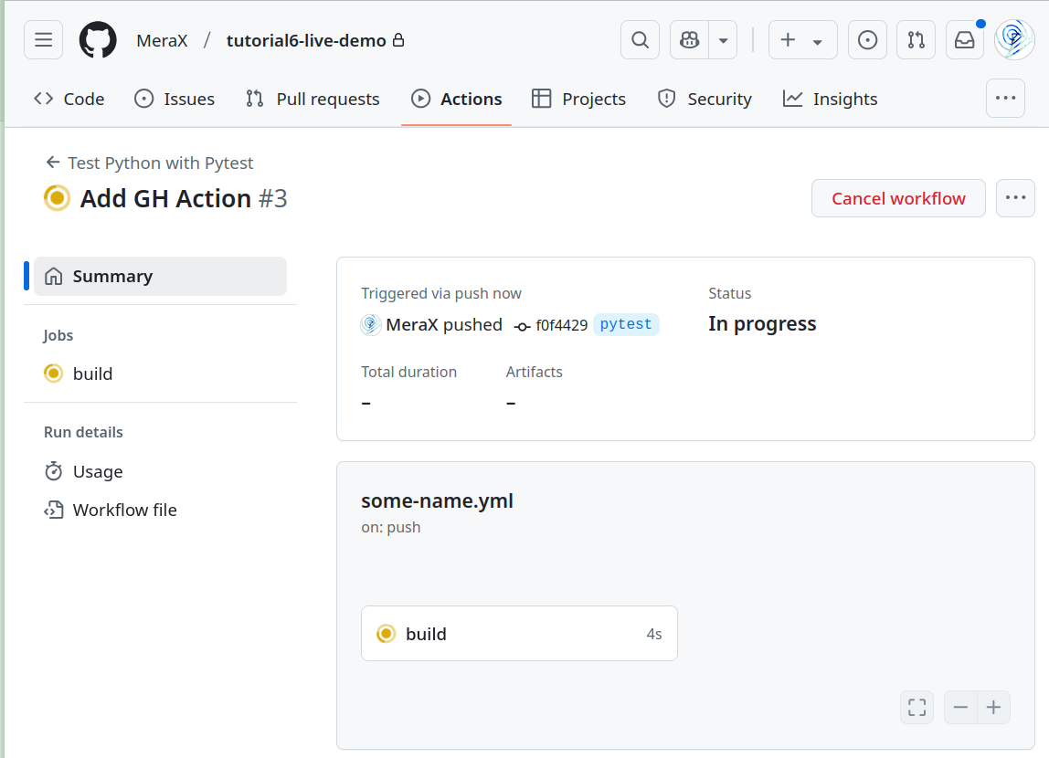
Simple GitHub Action with Pytest
# content of .github/workflows/some-name.yml
on: push
name: Test Python with Pytest
jobs:
build:
runs-on: ubuntu-latest
steps:
- uses: actions/checkout@v4
- name: Set up Python 3.10
uses: actions/setup-python@v3
with:
python-version: "3.10"
- name: Install and run pytest
run: |
python -m pip install pytest
pytest
https://docs.github.com/en/actions/automating-builds-and-tests/building-and-testing-python

Slide 15
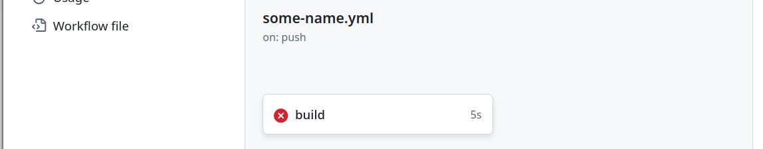
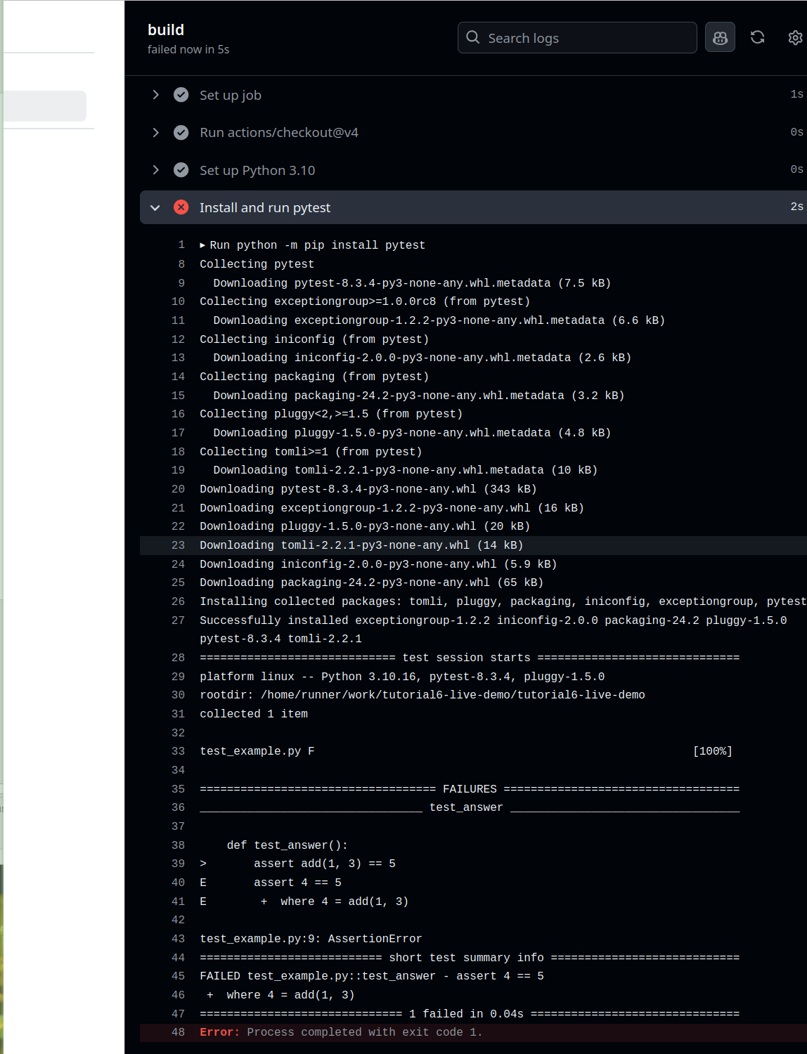
Simple GitHub Action with Pytest
# content of .github/workflows/some-name.yml
on: push
name: Test Python with Pytest
jobs:
build:
runs-on: ubuntu-latest
steps:
- uses: actions/checkout@v4
- name: Set up Python 3.10
uses: actions/setup-python@v3
with:
python-version: "3.10"
- name: Install and run pytest
run: |
python -m pip install pytest
pytest
https://docs.github.com/en/actions/automating-builds-and-tests/building-and-testing-python

Slide 16
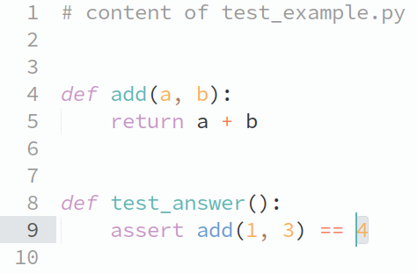
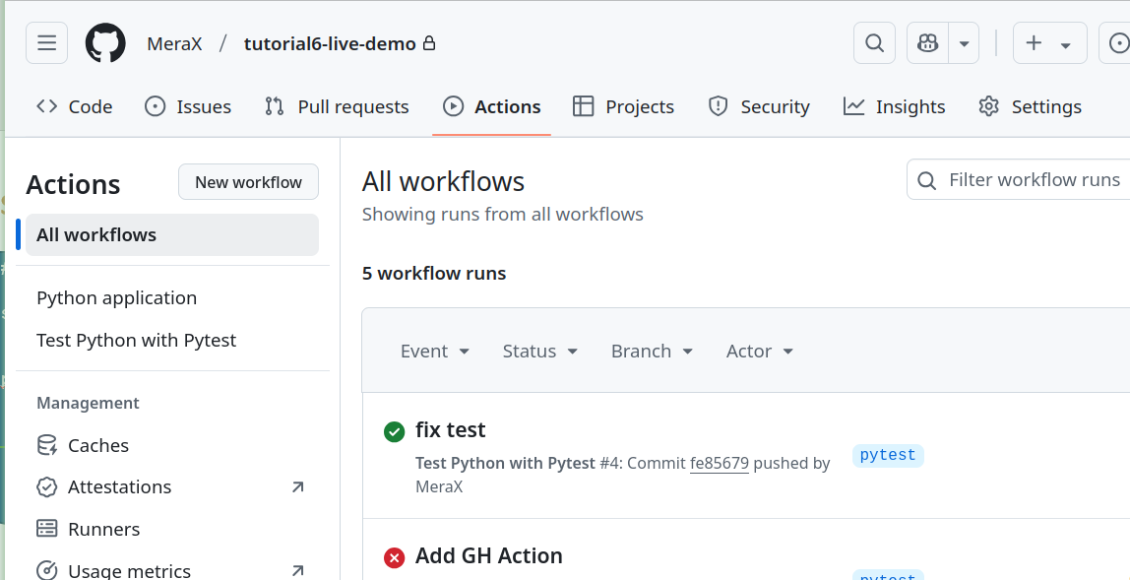
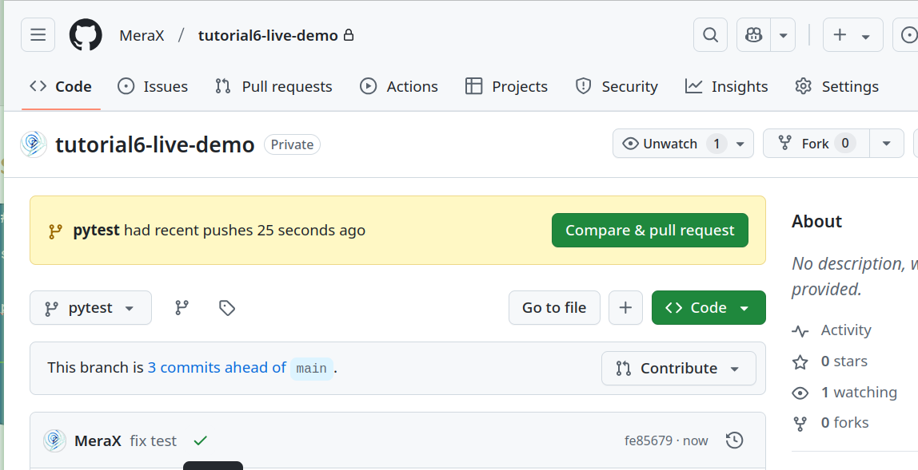
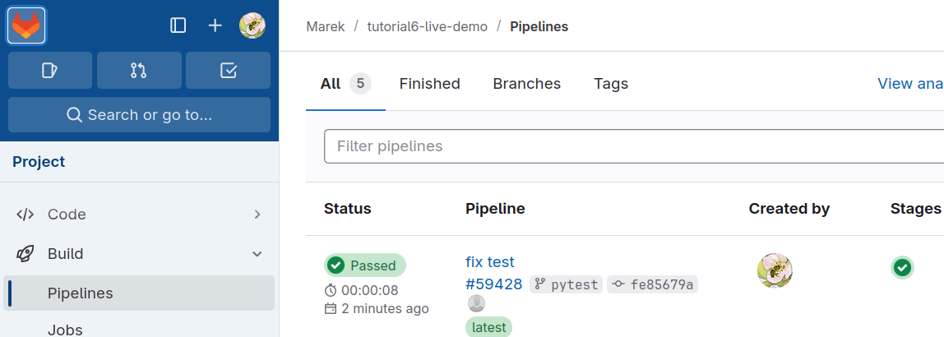
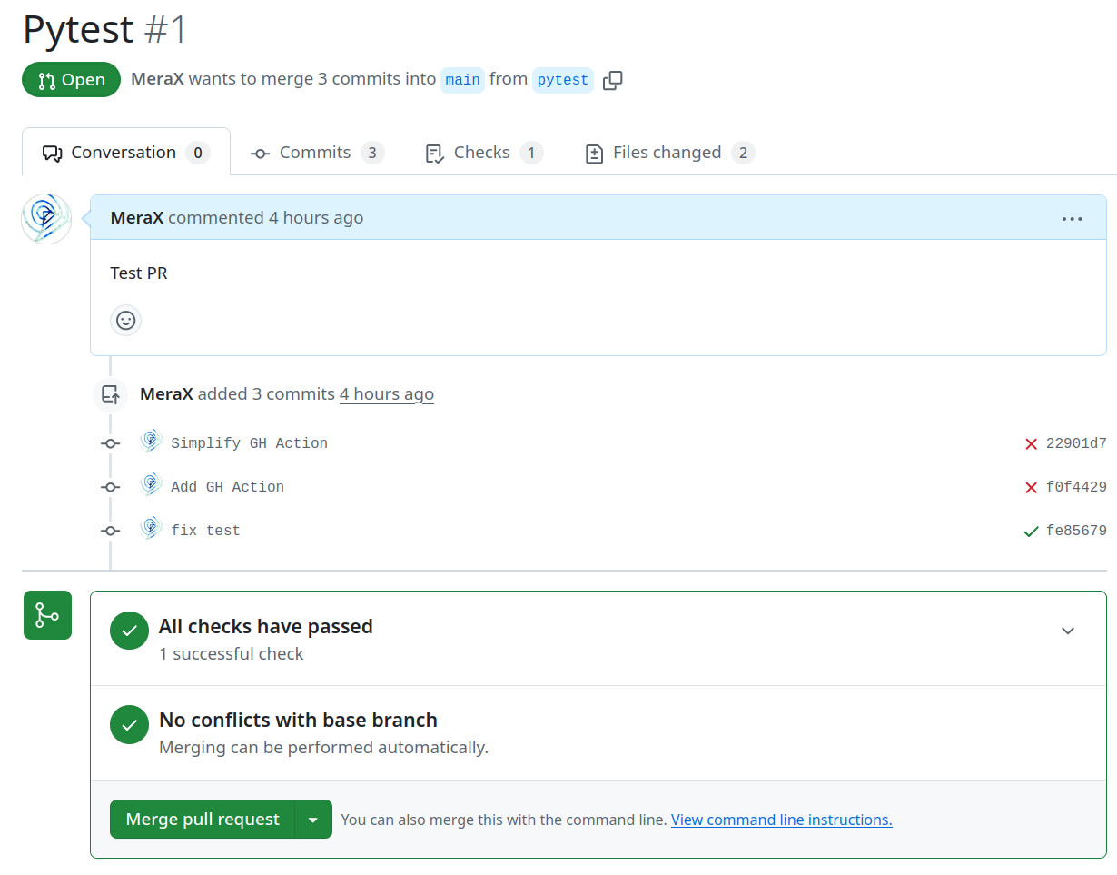
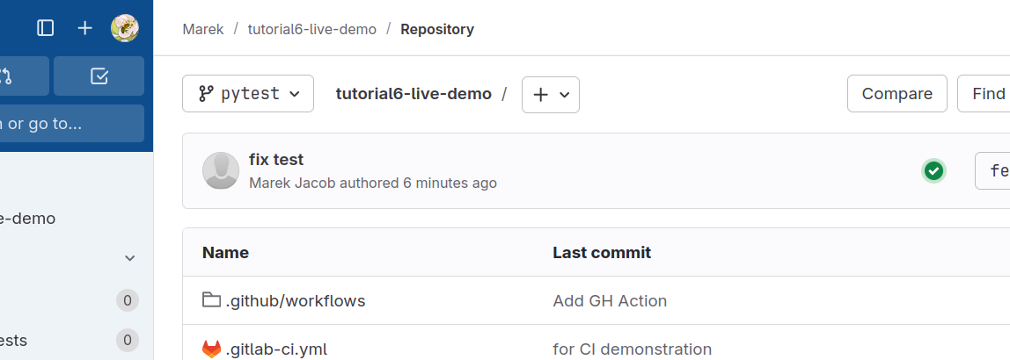
Fixed Test
Pull request

Slide 17
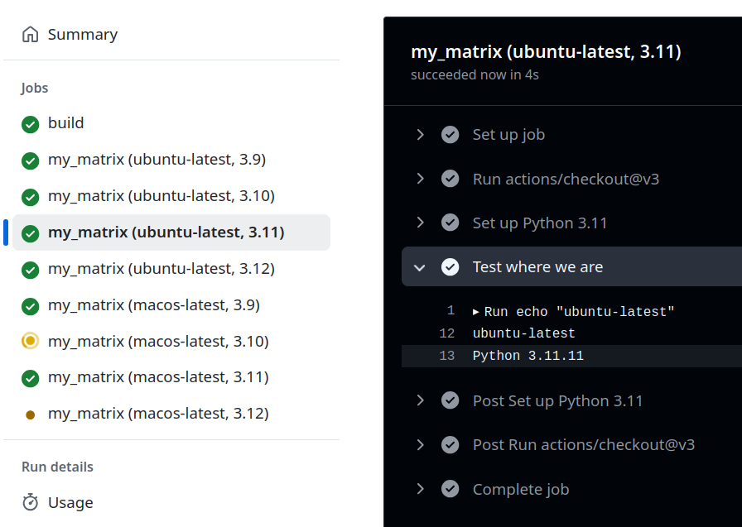
The Matrix Strategy (here with GitHub)
# content of .github/workflows/some-name.yml
on: push
name: Test Python with Pytest
jobs:
my_matrix:
strategy:
fail-fast: false
matrix:
platform: ["ubuntu-latest", "macos-latest"]
python-version: ["3.9", "3.10", "3.11", "3.12"]
runs-on: ${{ matrix.platform }}
steps:
- uses: actions/checkout@v3
- name: Set up Python ${{ matrix.python-version }}
uses: actions/setup-python@v5
with:
python-version: ${{ matrix.python-version }}
- name: Test where we are
run: |
echo "${{ matrix.platform }}"
python --version

Slide 18
Summary and Next Steps
Linters and pre-commit
Testing
Dependencies: trigger CI pipelines in other repositories
Build:
Compile binaries
Build containers
Build Python package
Compile Latex Document
Generate HTML Docs (Sphinx, jupyter-book, …)
Delivery & Deployment:
Release Package (on GitHub, GitLab, PyPI, …)
Publish documentation
Use variables reusable templates and the matrix strategy
Compiling, Linking, Packaging
Verification and testing
Deployment services
https://github.com/actions/create-release?tab=readme-ov-file

Slide 19
E-AI Basic Tutorials
Tutorial E-AI Basics 4: January Wednesday 22, 2025, 11-12 CET
"MLOps" - Machine Learning Operations
4.1 Overview (20') [RP]
4.2 MLOps in relation to traditional Weather forecasting (20') [MJ]
4.3 Road to MLOps (20’) [DN]
Tutorial E-AI Basics 5: February Wednesday 19, 2025, 11-12 CET
MLflow - an open-source platform for managing the machine learning lifecycle
5.1 Overview - User perspective (20') [TG]
5.2 Logging to MLflow as a ML software developer (20') [HT]
5.3 Running MLflow server as a user and as a service (20') [MJ]
Tutorial E-AI Basics 6: February Wednesday 26, 2025, 11-12 CET
CI/CD - Continuous Integration and Continuous Deployment of ML codes
6.1 Overview – What can CI/CD do for you? (20') [MJ]
6.2 Basic tests with Pytest (20’) [MJ]
6.3 Setting up a runner (20') [FP]
6.2
AI generated Image, © Marek Jacob 2024

Slide 20
Why Implement Software Tests?
Bug detection and prevention
Reliability and confidence
Facilitation of collaboration
Regression Prevention
Ensure code quality
Improve code design
Self-documentation of the code

Slide 21
Pytest
# content of test_example.py
def add(a, b):
return a + b
def test_answer():
assert add(1, 3) == 5
Pytest: a framework for writing (software) tests
Small and readable tests
Auto-discovery of test modules and functions
Detailed info on failing assert statements (no need to remember self.assert* names)
Modular fixtures for managing small or parametrized long-lived test resources
Can run unittest (including trial) test suites out of the box
Python 3.8+
Install: pip install pyptest
Auto-discovery:
Recurse into directories, search for test_*.py or *_test.py files
test prefixed test functions or methods (outside of classes)
test prefixed test functions or methods inside Test prefixed test classes
https://docs.pytest.org/

Slide 22
Asserting with the assert statements
def test_answer():
assert add(1, 3) == 4
def test_demo_with_message():
val = ...
assert val % 2 == 0, “even value expected”
import pytest
def test_zero_division():
with pytest.raises(ZeroDivisionError):
1 / 0
import torch
def some_f():
return torch.Tensor([3.14])
def test_torch():
val = some_f()
torch.testing.assert_close(
actual=val,
expected=torch.Tensor([torch.pi]),
atol=0.002,
rtol=0.0000001,
)
https://pytorch.org/docs/stable/testing.html

Slide 23
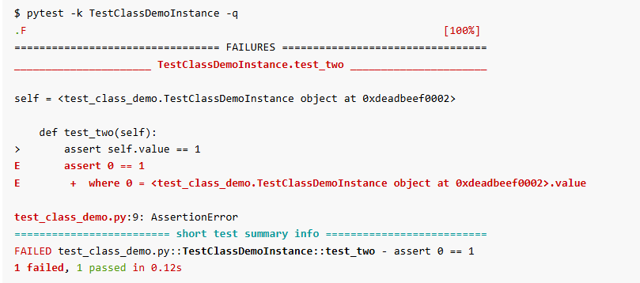
Group multiple tests in a class
class TestClass:
def test_one(self):
x = "this"
assert "h" in x
def test_two(self):
x = "hello"
assert hasattr(x, "check")
Organise tests
Share fixtures only for a certain set of tests
Applying marks for a set of tests
Note: each test has its unique instance of the class
class TestClassDemoInstance:
value = 0
def test_one(self):
self.value = 1
assert self.value == 1
def test_two(self):
assert self.value == 1

Slide 24
Fixture / Test Context
import pytest
@pytest.fixture
def simple_data():
return [42]
def test_simple_data(simple_data):
assert simple_data[0] == 42
assert len(simple_data) == 1
def test_two(simple_data):
simple_data.append(23)
assert sum(simple_data) == 47
A Fixture sets up the system state and input data needed for test execution
Define fixture as factory function with the @pytest.fixture decorator
Fixture resolution:
Pytest finds tests
test_simple_data
Inspects arguments
simple_data
Finds fixture with same name
simple_data()
Execute fixture and pass return value
Examine test
test_simple_data([42])
simple_data=[42]
test_two
test_two([42])
simple_data=[42]
Fixtures can request other fixtures
@pytest.fixture
def array1D(simple_data)
return np.array(simple_data)

Slide 25
Mark test functions with attributes
Add metadata on tests with pytest.mark
E.g. Marking test functions and selecting them for a run
import pytest, torch
@pytest.fixture
def x_gpu():
return torch.Tensor([42]).cuda()
@pytest.mark.gpu
def test_cuda(x_gpu):
assert x_gpu.is_cuda
assert not x_gpu.cpu().is_cuda
GPU System
$ pytest
pass
CPU System
$ pytest
fail
CPU System
$ pytest –m “not gpu”
pass

Slide 26
Mark test functions with attributes
Add metadata on tests with pytest.mark
import sys, pytest
@pytest.mark.skipif(sys.version_info < (3, 10), reason="requires python3.10 or higher")
def test_function(): ...
@pytest.mark.skipif(sys.platform == "win32", reason="does not run on windows")
class TestPosixCalls:
def test_function(self):
"will not be setup or run under 'win32' platform“
@pytest.mark.parametrize("n,expected", [(1, 2), (3, 4)])
class TestClass:
def test_simple_case(self, n, expected):
assert n + 1 == expected
def test_weird_simple_case(self, n, expected):
assert (n * 1) + 1 == expected
https://docs.pytest.org/en/stable/how-to/skipping.html#skipif
https://docs.pytest.org/en/stable/how-to/parametrize.html

Slide 27
Monkeypatching / Mocking
Mocking helps when tested functionality depends on global settings, file in a filesystem or invokes code that cannot be easily tested such as network access.
import xarray, numpy
def my_processing(filename):
data = xarray.open_dataset(filename)
# some processing
return data
def open_dataset_mock(*kwargs, **args):
return xarray.Dataset({"X": numpy.arange(5)})
def test_processing(monkeypatch):
monkeypatch.setattr(xarray, "open_dataset", open_dataset_mock)
x = my_processing("no-name.nc")
assert x.X.sum() == 10
my_processing:
Some (external) functionality that depends on using open_data. External constraints forbid refactoring it to my_processing(data).
open_dataset_mock:
Function mocking up xarray.open_data
monkeypatch:
A build-in fixture. (No import etc.)

Slide 28
How to start testing?
Just do it!
Implement a test ensures no exceptions are raised
Identify the call signature
Prepare input data (fixture)
Validate the return value
For complex object, start testing attributes
Add detailed tests progressively
Be cautious with numerical results (machine dependence)
Add tests when discovering and solving a bug
Develop tests for new features
Enhance Testability. Refactor interfaces
Ensure inputs are easy
Ensure outputs are easy to interpret and predict

Slide 29
E-AI Basic Tutorials
Tutorial E-AI Basics 4: January Wednesday 22, 2025, 11-12 CET
"MLOps" - Machine Learning Operations
4.1 Overview (20') [RP]
4.2 MLOps in relation to traditional Weather forecasting (20') [MJ]
4.3 Road to MLOps (20’) [DN]
Tutorial E-AI Basics 5: February Wednesday 19, 2025, 11-12 CET
MLflow - an open-source platform for managing the machine learning lifecycle
5.1 Overview - User perspective (20') [TG]
5.2 Logging to MLflow as a ML software developer (20') [HT]
5.3 Running MLflow server as a user and as a service (20') [MJ]
Tutorial E-AI Basics 6: February Wednesday 26, 2025, 11-12 CET
CI/CD - Continuous Integration and Continuous Deployment of ML codes
6.1 Overview – What can CI/CD do for you? (20') [MJ]
6.2 Basic tests with Pytest (20’) [MJ]
6.3 Setting up a runner (20') [FP]
6.3
AI generated Image, © Marek Jacob 2024

Slide 30

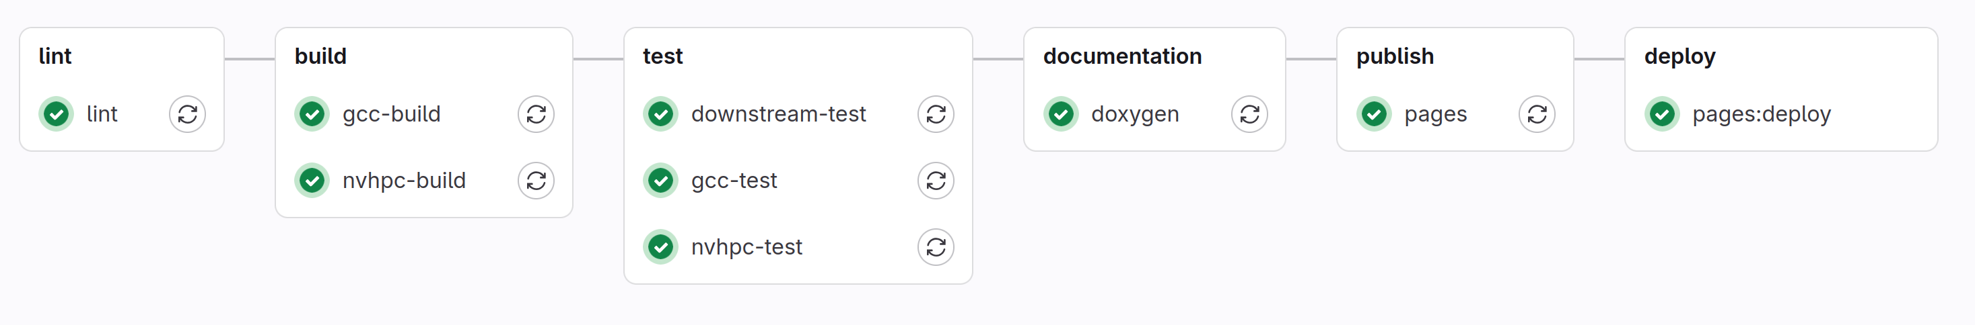
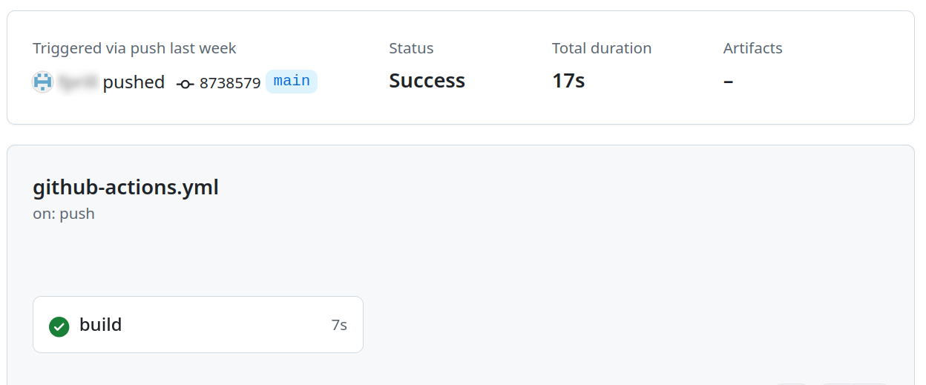


typical CI/CD pipeline
Tools for Continuous Integration and Continuous Deployment
JOB specific task to be executed in the pipeline
Stage group of jobs, defines the order of execution

Slide 31

ExampleS FOR CI/CD JOBS
Automated building: Compiling source code into executable programs
Automated testing: Running various types of tests to catch bugs (ctest, pytest)
Artifact generation: Creating deployable artifacts such as container images
Maintaining consistency: Linters help enforce coding standards and conventions across a project
Security scanning: Performing automated security checks
Automated documentation generation: CI/CD pipelines can automatically generate documentation from source code comments or dedicated documentation files (e.g. LaTeX)

Slide 32



Definitions
CI/CD runner lightweight "agent", picks up CI jobs through the coordinator API of GitLab/Github CI/CD, runs the job, and sends the results back to the GitLab/Github instance
CI/CD rules allow for fine-grained control over job execution
Data retrieval
Data retrieval Runners clone the project repository, settings can be shared through CI/CD variables or environment variables
Artifact passing Jobs can produce build outputs, test results, or any other generated files that are then consumed by subsequent jobs in the pipeline
Containers Many runners use Docker containers as their execution environment. Each job runs in its own isolated Docker container
Artifact passing

Slide 33





Self-hosted runners
Self-hosted runners offer more control of hardware, operating system, and software tools.
Examples:
custom software and dependencies: compiling source code with different compilers or running tests with different versions of Python or PyTorch
specialized hardware: e.g. test execution on a runner with GPU capability
Cons:
Security: can potentially run dangerous code on your self-hosted runner machine by creating a pull request that executes the code in a workflow.
A usually idle CI/CD runner is expensive!
Setting up your own runner is even more relevant for Gitlab because Gitlab is often set up on a local server while Github offers GitHub-hosted runners.
/

Slide 34
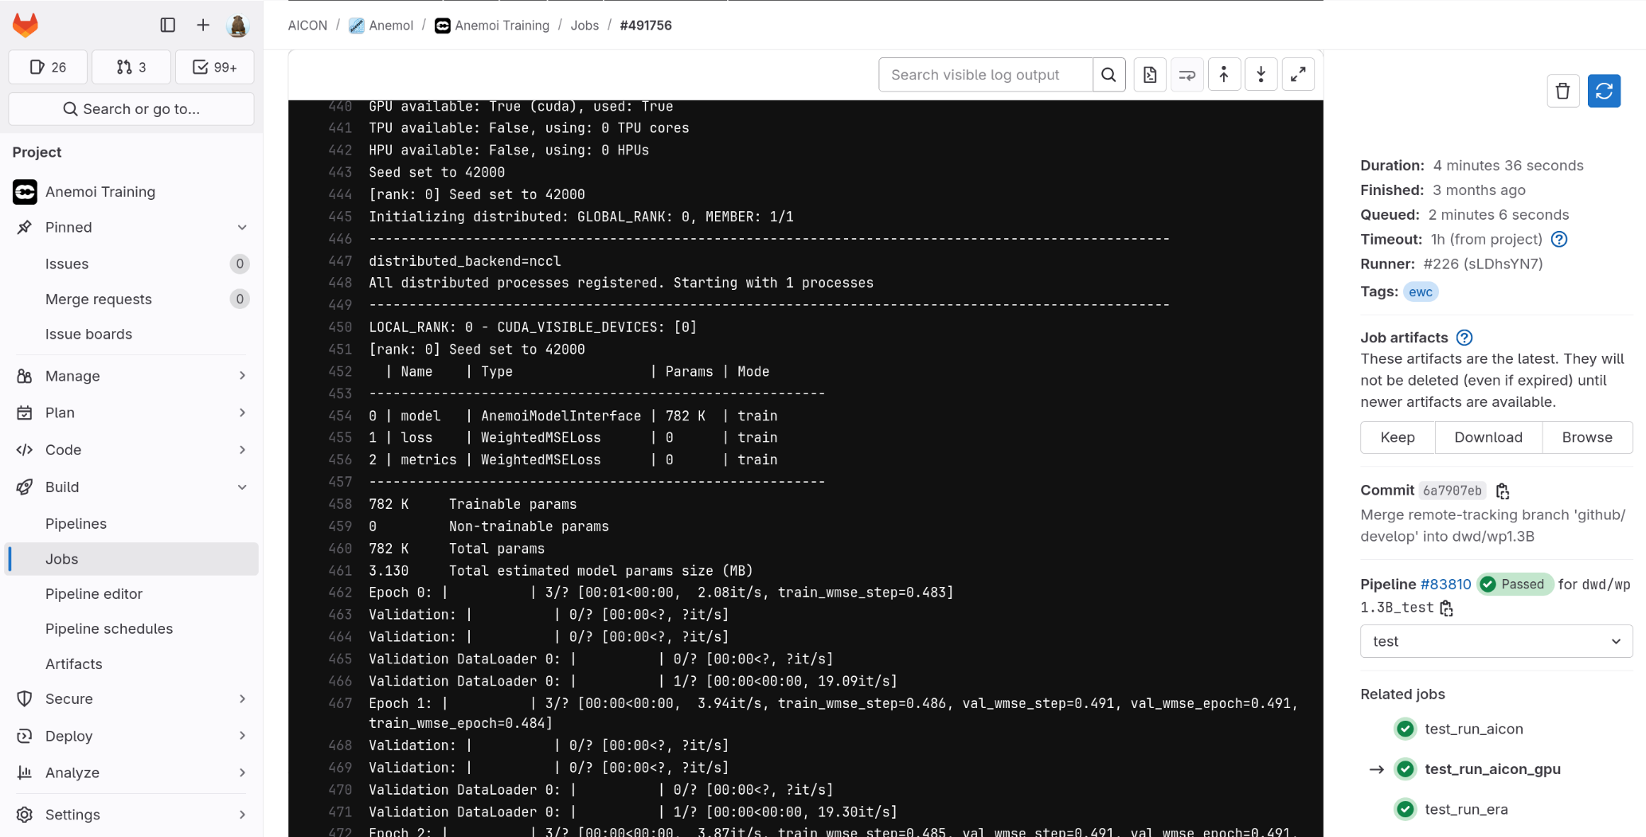

example (screenshot)
CI/CD test of AnemoI executed on a GPU-capable runner
(Gitlab, execution environment: EWC)

Slide 35

EWC / European Weather Cloud
Installation of a GPU-capable CI/CD runner in the EWC
cloud-based collaboration platform for meteorological application development and operations in Europe.
jointly operated by the European Centre for Medium-Range Weather Forecasts (ECMWF) and EUMETSAT on behalf of their member states.
Reminder (again): Just an example! Occupying one of EWC's scarce VM slots should be the exception! Our CI/CD runner scenario does not make use of special EWC assets like data proximity – a waste of resources!
This example focuses on Gitlab, an explanation for Github actions will follow at the end.

Slide 36

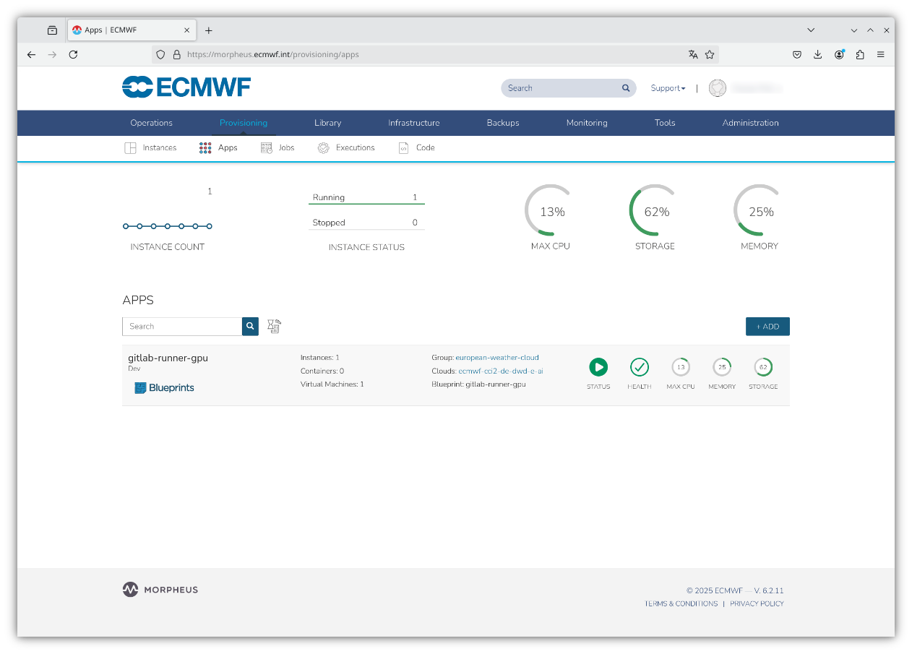
EWC Application Blueprint
The first steps define the presets for the virtual machine used for the EWC runner. They are performed in the EWC portal with the Morpheus cloud management software.
EWC-Dashboard log into the Morpheus cloud management platform: https://morpheus.ecmwf.int//login
Create user, add SSH key
Create user group
Create App Blueprint gitlab-runner-gpu (navigate: Library/Blueprints/App Blueprints)
Target hardware and VM (example):
Instance `8cpu-64gbmem-30gbdisk-a100`
GRID A100D-1-10C (Virtual GPU software)
NVIDIA Driver Version: 525.105.17, CUDA Version: 12.0
Linux distribution: Rocky Linux 9.3

Slide 37
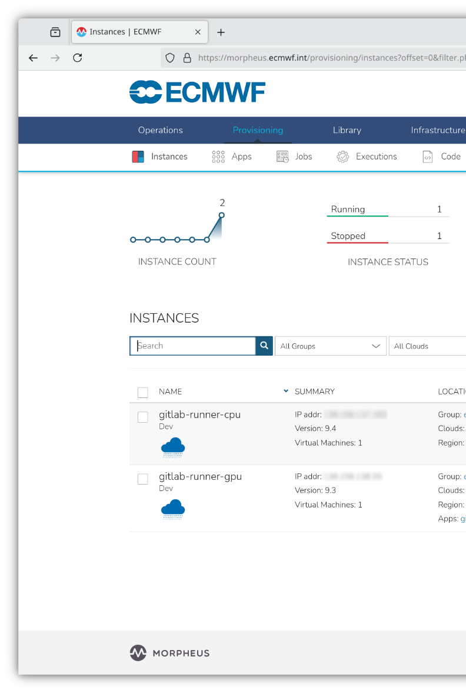
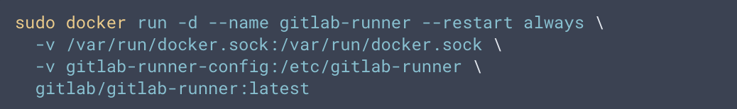
Initializing the VM
Provisioning/App: Run the App Blueprint that has been defined above. This starts the cloud instance ~ virtual machine (VM).
When the instance is running adjust presets:
additional storage for caching (“Actions/Reconfigure”)
log into the instance with ssh, install docker runtime and move docker cache
Pull the GitLab Runner Docker image and start the GitLab Runner container:
INSTANCE

Slide 38
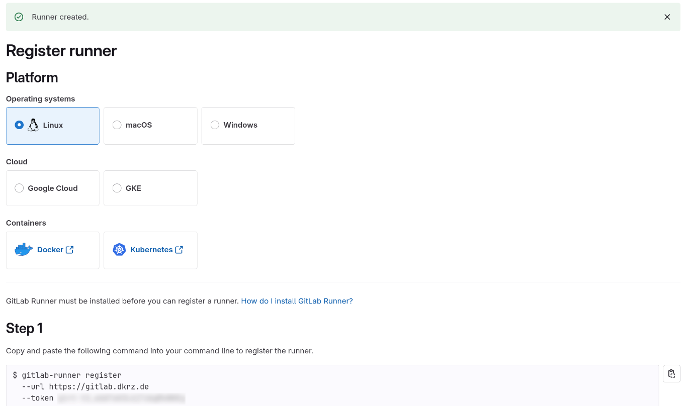

Registration of self-hosted runner (Gitlab)
Assign the new Project Runner to the Gitlab Project (navigate: Settings/CICD/Runners)
Choose a tag to specify jobs that the runner can run (ex.: “ewc”)
Register the runner with the provided token
Note: no need to allow Gitlab/GitHub to make inbound connections to your self-hosted runner
Details for GPU enabling
For privileged and GPU execution modify the config.toml settings: pull_policy (use local image, no registry) privileged gpus
CI/CD Runner token

Slide 39
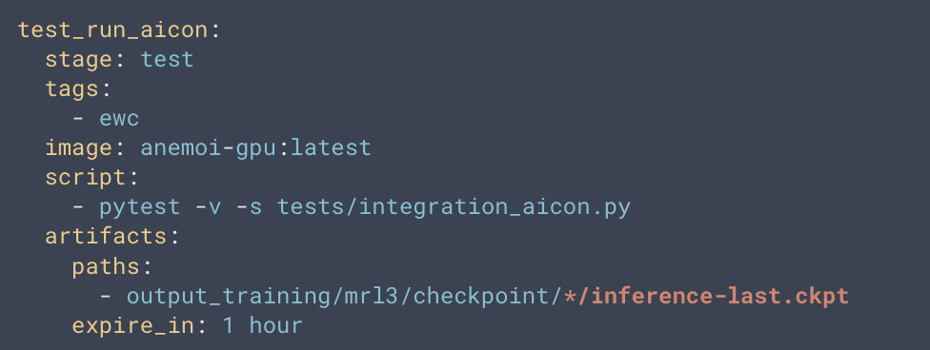
Example: CI/CD action
The .gitlab-ci.yml file is a crucial component of GitLab's CI/CD system: It is a YAML configuration file placed in the root directory of a GitLab repository.
Code snippet from .gitlab-ci.yml:
CI/CD Runner tag new commits triggers pipeline, including GPU runner

Slide 40
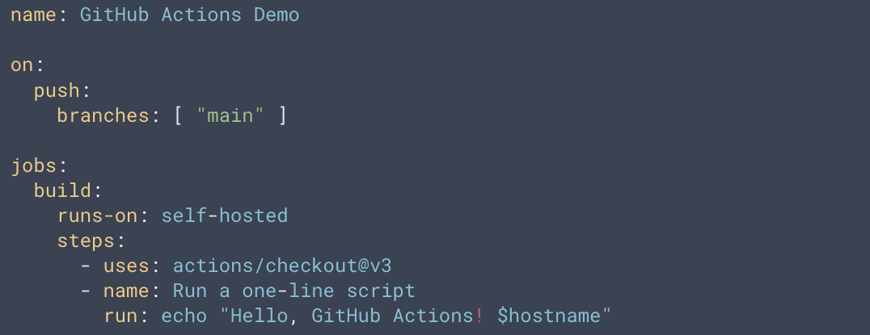
Github actions
GitHub Actions workflow file, typically .github/workflows/github-actions.yml:
equivalent of the GitLab CI/CD configuration file (.gitlab-ci.yml).
"Github actions": details on installation procedure
To set up a custom GitHub Actions runner:
Go to your GitHub repository settings.
Click on "Actions" in the left sidebar.
Click on "Runners" and then "New self-hosted runner".

Slide 41
Web resources
Rather advanced and rapidly changing topic (depending on software versions)
Official Gitlab documentation on self-hosted runners: https://docs.gitlab.com/runner/
Official Github documentation: https://docs.github.com/en/actions/hosting-your-own-runners/managing-self-hosted-runners
Morpheus: cloud management platform for the EWC: https://docs.morpheusdata.com, https://docs.morpheusdata.com
EWC, reconfiguration of disk space: https://confluence.ecmwf.int/display/EWCLOUDKB/Adding+extra+disk+storage+to+your+instances
GPU-capable Docker images: https://docs.nvidia.com/datacenter/cloud-native/container-toolkit/latest/install-guide.html

Slide 42
Further Information on E-AI
Slides available at GitHub https://github.com/eumetnet-e-ai/tutorials
Recording will be available at EUMETNET SharePoint https://tlnt19059.sharepoint.com/:f:/r/sites/E-AI/Shared%20Documents/Tutorials
Register for E-AI updates and SharePoint Access: marek.jacob@eumetnet.eu
Contacts:
Florian Prill: Florian.Prill@dwd.de
Marek Jacob: Marek.Jacob@dwd.de

